Slide 1
Eliminating Useless Symbols
“we define those symbols that do not participate in derivation of any string, called as useless symbol in Context Free Grammar (CFG)”

Slide 2
Eliminating Useless Symbols : Example
A→B
B→a
D→b
Here D→b is a useless production, since it cannot participating
2.
S -> abS | abA | abB
A -> cd
B -> aB
C -> dc
C→dc is a useless production, since it cannot participating

Slide 3
Generating and Reachable
If X is generating, i.e., X =>w
If X is reachable If there is a derivation S =>* αXβ =>* w

Slide 4
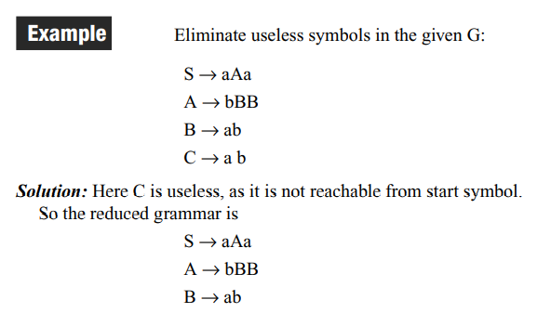
Generating and Reachable

Slide 5
Computing the generating symbols
Base Case: All elements of T are generating.
Inductive Step: If a production A → α is such that all symbols of α are known to be generating, then A is also generating.
Example: Find out generating and not generating symbol
S → aS | W | U
W → aW
U → a
V → aa
Solution:
a is generating.
U and V are generating since U → a and V → aa.
S is generating since S → U.
W is however not generating

Slide 6
Computing reachable symbols
Base Case: The start variable S is reachable.
Inductive Step: If A is reachable and we have a production A → α then all symbols in α are reachable
Example:
Consider the grammar given by the rules:
S → aB | BC
A → aA | c | aDb
B → DB | C
C → b D → B
Find out which symbols are reachable and not reachable ?
Solution:
S is reachable. Hence a, B and C are reachable. Then b and D are reachable.
However A and c are not reachable.

Slide 7
Eliminating є -productions
Example 1: Eliminate null productions from the following CFG productions
S -> aSb/aAb/ab/a A -> ε
Solution:
So only A is generating ε Thus ε does not belong to the language
Replace ε in the place of A in R.H.S. we got following resulting production
S -> aSb/aAb/ab/a

Slide 8
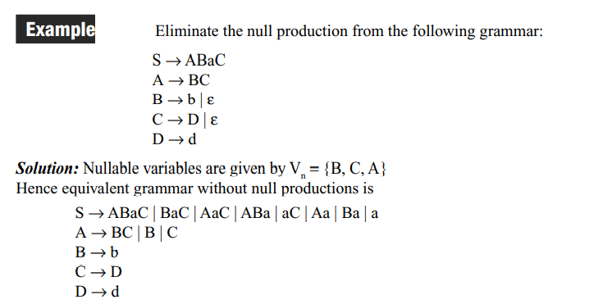
Example

Slide 9
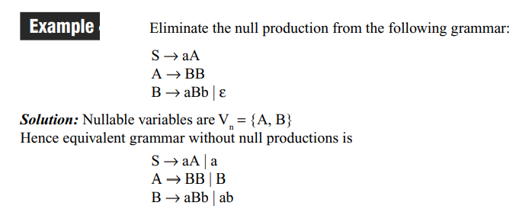
Example

Slide 10
Eliminating Unit Productions
Definition: A unit production is a production of the form A → B

Slide 11
Example

Slide 12
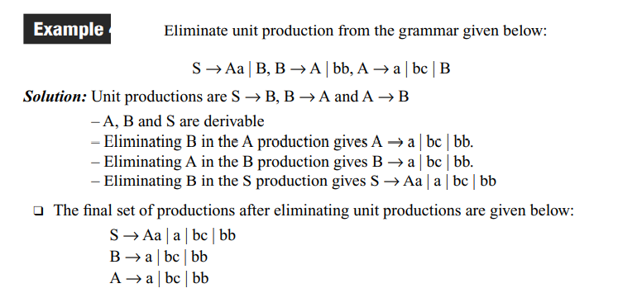
Example

Slide 13
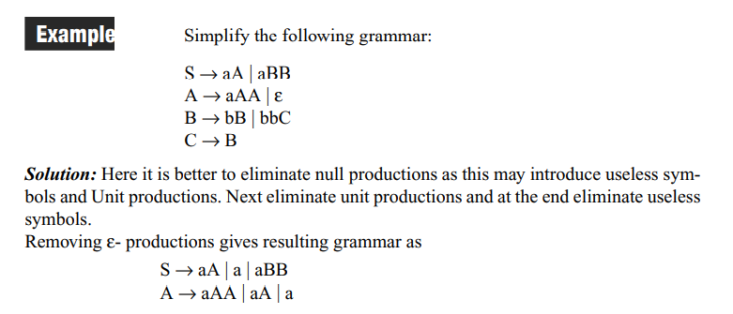
Example

Slide 14
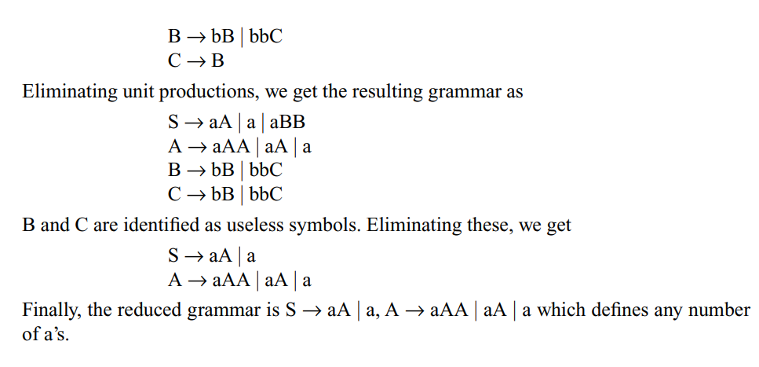
Example

Slide 15
Chomsky Normal Form

Slide 16
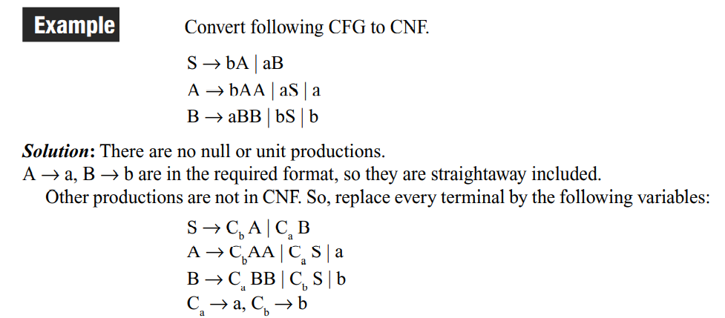
Example

Slide 17
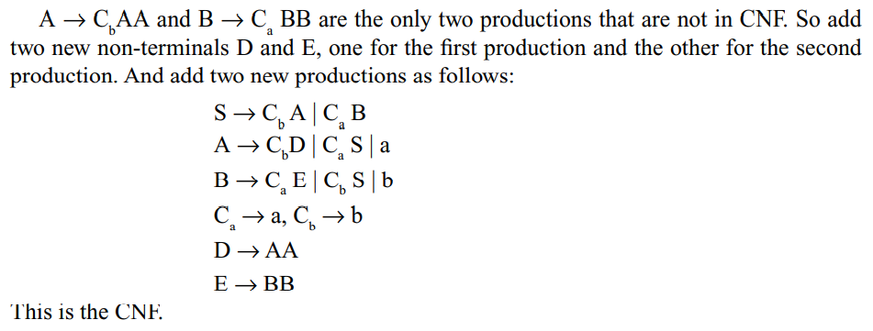
Example

Slide 18
Example

Slide 19
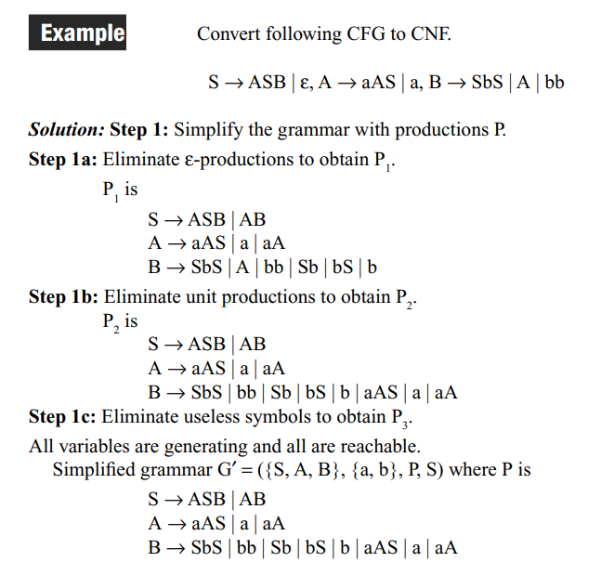
Example

Slide 20
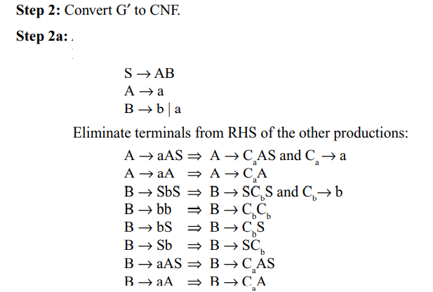
Example

Slide 21
Example

Slide 22
Greibach Normal Form
Definition
A context free language is said to be in the Greibach normal form if all productions are of the form
A→ aα where a ∈ T and α ∈ V*.

Slide 23
Greibach Normal Form
Lemma1 (Substitution rule)
Let G = {V, T, P, S} be a CFG.
Let A → Bα be a production in P if there is a production B → β1 | β2 | β3 | β4 ……….
Then the equivalent grammar can be obtained by substituting B in A.
The resulting grammar is A → β1 α | β2 α | β3 α | β4 α

Slide 24
Greibach Normal Form
Lemma 2 (Elimination of left recursion)
We can generalize this grammar. For any CFG given as A → A α1 | A α2 | A α3 ….. | β1 | β2 | β3 | …… the equivalent grammar after eliminating left recursion is
A → β1 A′| β2 A′| β3 A′| ……| β1 | β2 | β3 | ……
A′ → α1 A′| α2 A′| α3 A′|….. | α1 | α2 | α3 …

Slide 25
Greibach Normal Form
Procedure to Convert the given Grammar to GNF
Eliminate null productions and unit productions, and construct CNF.
2. Rename variables as A₁ A₂ ….. starting with S as A₁
3. For each production of the form Ai → Aj α, apply the following:
a) if j > i --- leave the productions as they are
b) if j = i --- apply Lemma 2
c) if j < i --- apply Lemma 1

Slide 26
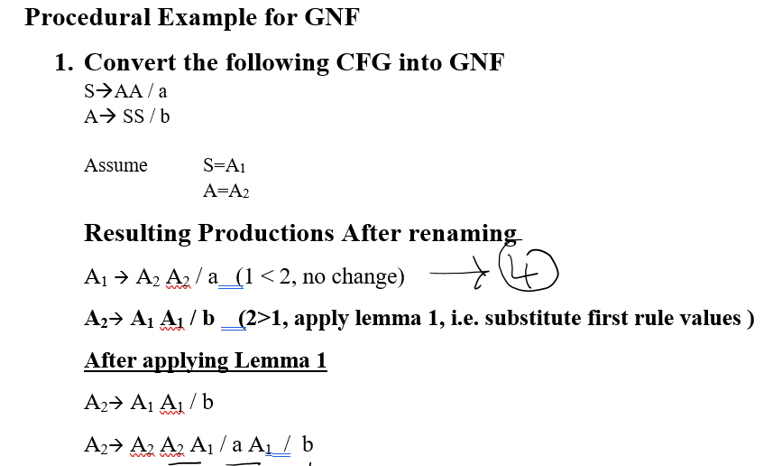
Example

Slide 27
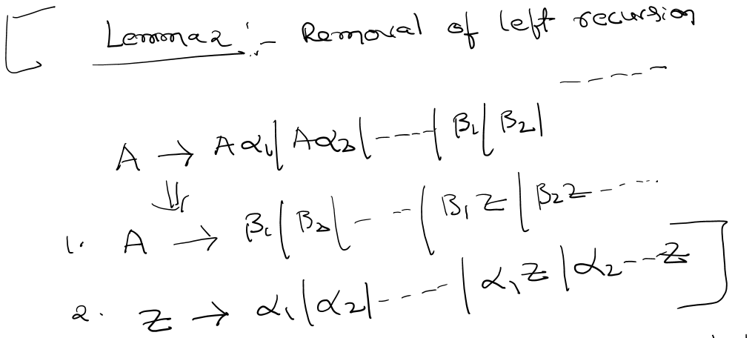
Example

Slide 28
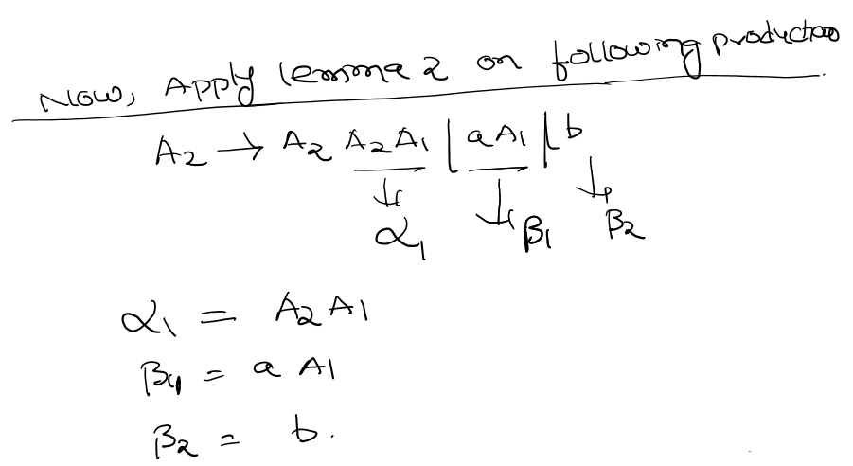
Example

Slide 29
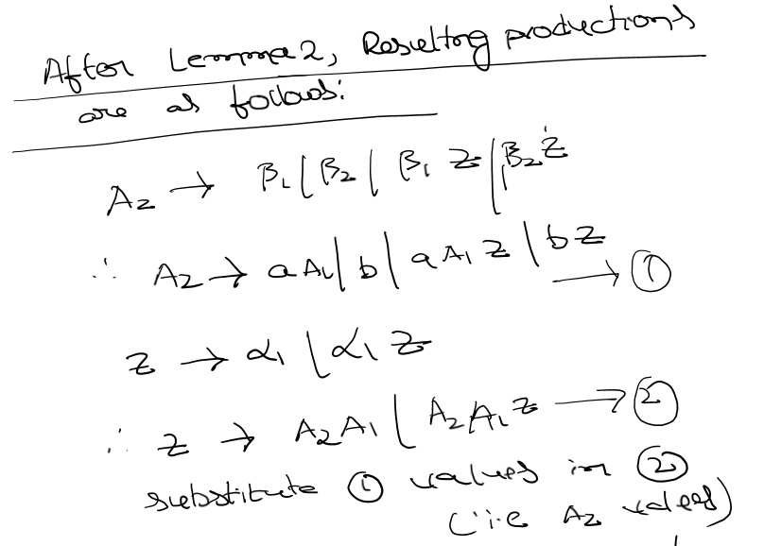
Example

Slide 30
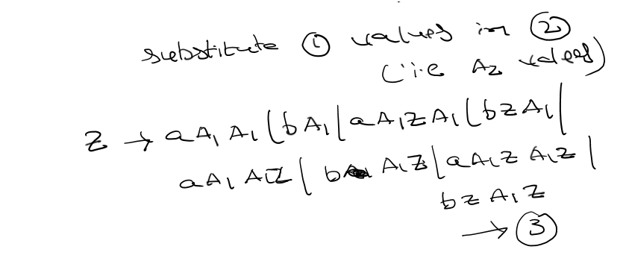
Example

Slide 31
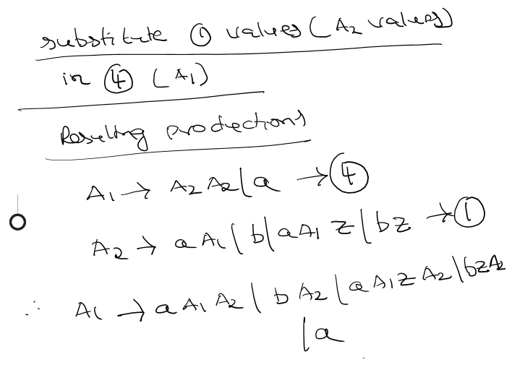
Example

Slide 32
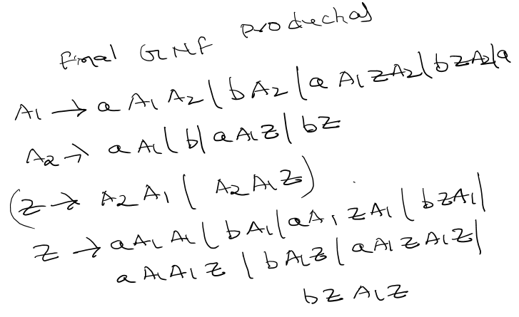
Example

Slide 33
Example

